Slide 1

API TESTING
By,
LINGESHWAR.S
CSE-B

Slide 2
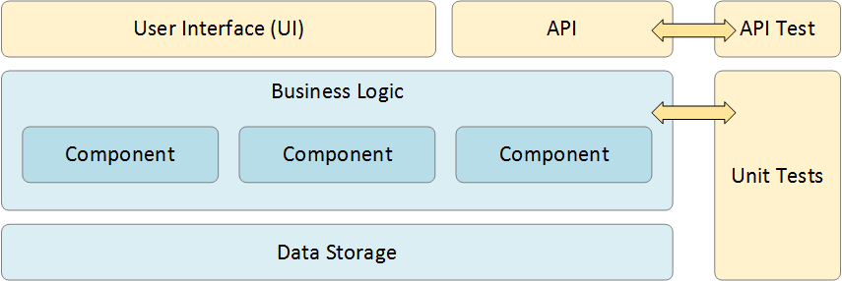
API Testing
It is a software testing type that validates Application Programming Interfaces (APIs).
Purpose of API Testing: To check the functionality, reliability, performance, and security of the programming interfaces.
API defines requests that can be made, how to make requests, data formats that can be used between two software systems.

Slide 3
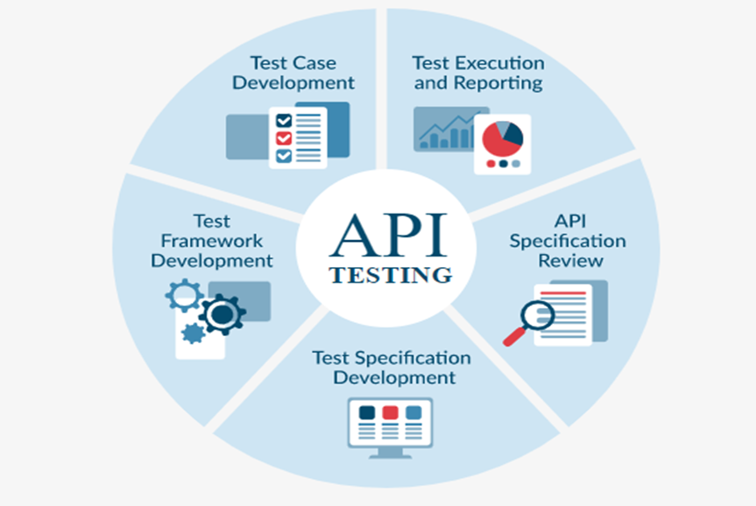
API Testing Approach:
API Testing Approach is a predefined method that the QA team will perform in order to conduct the API testing after the build is ready.
This testing does not include the source code.
It helps to understand
Functionalities
Testing techniques
Input parameters
Execution of test cases

Slide 4
Types of API Testing:
Types of API testing
Validation testing
Unit testing
Load testing
Security testing
Integration testing
Performance testing

Slide 5

Tools for API testing: Here are some of the tools of API testing.
Test API with Postman, Rest-assured, Katalon, SoapUI etc.…,
The above mentioned are different tools used for API Testing. This presentation is about API test with POSTMAN. The steps, working procedures of POSTMAN are as follows.

Slide 6

Test API with Postman
What is Postman?
Postman is a scalable API testing tool. API stands for Application Programming Interface which allows software applications to communicate with each other via API calls.
Why use Postman?
Accessibility
Creating Environments
Creation of Tests
Automation Testing

Slide 7
Authentication & Authorization
Authentication is a process to prove that you are the person who you intend to be.
Authorization is the process of giving access to someone. If you are Authorized then you have access to that resource. To Authorize you need to present credentials
So in order to access APIs, proper authorization is needed. It may be in the form of a username and password, bearer token…
Here are some of the terms of authentication and authorization.
Basic authentication (Least secure way)
b) Bearer Token
c) API Key
d) Oauth (Most secure way)

Slide 8
THANK YOU

